Slide 1
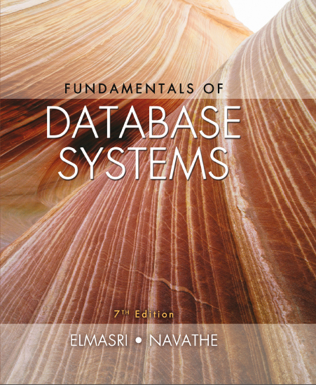
Fundamentals of Database Systems
Seventh Edition
Chapter 16
Disk Storage, Basic File Structures, Hashing, and Modern Storage Architectures
Copyright © 2016, 2011, 2007 Pearson Education, Inc. All Rights Reserved
Notes:
If this PowerPoint presentation contains mathematical equations, you may need to check that your computer has the following installed:
1) MathType Plugin
2) Math Player (free versions available)
3) NVDA Reader (free versions available)

Slide 2
16.1 Introduction
Databases typically stored on magnetic disks
Accessed using physical database file structures
Storage hierarchy
Primary storage
C P U main memory, cache memory
Secondary storage
Magnetic disks, flash memory, solid-state drives
Tertiary storage
Removable media

Slide 3
Memory Hierarchies and Storage Devices
Cache memory
Static RAM
D RAM
Mass storage
Magnetic disks
C D-ROM, D V D, tape drives
Flash memory
Nonvolatile

Slide 4
Storage Types and Characteristics
Table 16.1 Types of Storage with Capacity, Access Time, Max Bandwidth (Transfer Speed), and Commodity Cost
Type | Capacity* | Access Time | Max Bandwidth | Commodity Prices (2014)**
Main Memory- R A M | 4G B–1T B | 30n s | 35G B/sec | $100–$20K
Flash Memory- S S D | 64 G B–1T B | 50 mu s | 750M B/sec | $50–$600
Flash Memory- U S B stick | 4G B–512G B | 100 mu s | 50M B/sec | $2–$200
Magnetic Disk | 400 G B–8T B | 10m s | 200M B/sec | $70–$500
Optical Storage | 50G B–100G B | 180m s | 72M B/sec | $100
Magnetic Tape | 2.5T B–8.5T B | 10s–80s | 40–250M B/sec | $2.5K–$30K
Tape jukebox | 25T B–2,100,000T B | 10s–80s | 250M B/sec–1.2P B/sec | $3K–$1M+
*Capacities are based on commercially available popular units in 2014.
**Costs are based on commodity online marketplaces.

Slide 5
Storage Organization of Databases
Persistent data
Most databases
Transient data
Exists only during program execution
File organization
Determines how records are physically placed on the disk
Determines how records are accessed

Slide 6
16.2 Secondary Storage Devices (1 of 4)
Hard disk drive
Bits (ones and zeros)
Grouped into bytes or characters
Disk capacity measures storage size
Disks may be single or double-sided
Concentric circles called tracks
Tracks divided into blocks or sectors
Disk packs
Cylinder

Slide 7
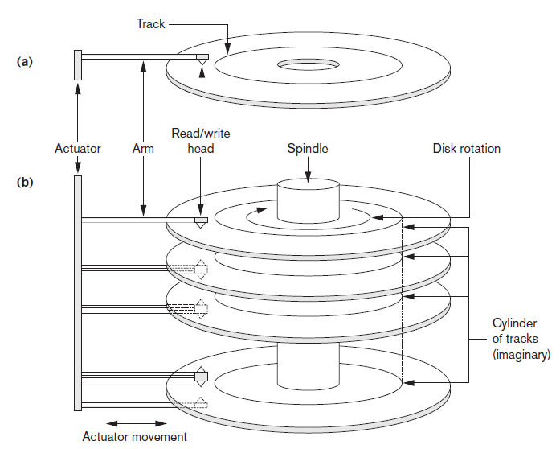
Single-Sided Disk and Disk Pack
Figure 16.1 (a) A single-sided disk with read/write hardware (b) A disk pack with read/write hardware

Slide 8
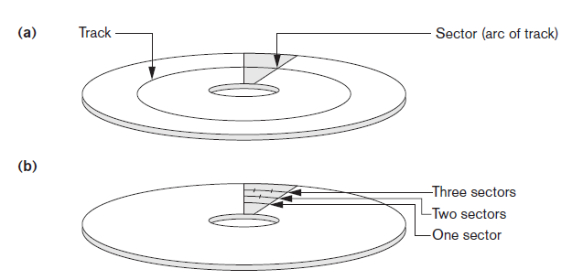
Sectors on a Disk
Figure 16.2 Different sector organizations on disk (a) Sectors subtending a fixed angle (b) Sectors maintaining a uniform recording density

Slide 9
16.2 Secondary Storage Devices (2 of 4)
Formatting
Divides tracks into equal-sized disk blocks
Blocks separated by interblock gaps
Data transfer in units of disk blocks
Hardware address supplied to disk I/O hardware
Buffer
Used in read and write operations
Read/write head
Hardware mechanism for read and write operations

Slide 10
16.2 Secondary Storage Devices (3 of 4)
Disk controller
Interfaces disk drive to computer system
Standard interfaces
S C S I
S A T A
S A S

Slide 11
16.2 Secondary Storage Devices (4 of 4)
Techniques for efficient data access
Data buffering
Proper organization of data on disk
Reading data ahead of request
Proper scheduling of I/O requests
Use of log disks to temporarily hold writes
Use of S S Ds or flash memory for recovery purposes

Slide 12
Solid State Device Storage
Sometimes called flash storage
Main component: controller
Set of interconnected flash memory cards
No moving parts
Data less likely to be fragmented
More costly than H D D s
D RAM-based S S D s available
Faster access times compared with flash

Slide 13
Magnetic Tape Storage Devices
Sequential access
Must scan preceding blocks
Tape is mounted and scanned until required block is under read/write head
Important functions
Backup
Archive

Slide 14
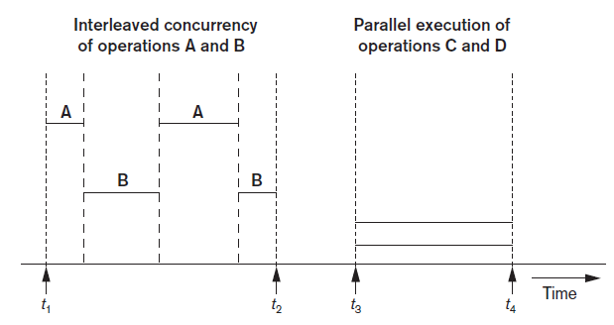
16.3 Buffering of Blocks (1 of 2)
Buffering most useful when processes can run concurrently in parallel
Figure 16.3 Interleaved concurrency versus parallel execution

Slide 15
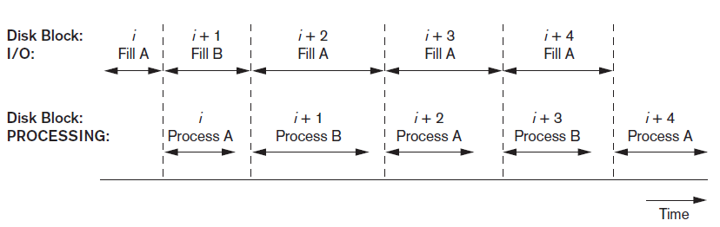
16.3 Buffering of Blocks (2 of 2)
Double buffering can be used to read continuous stream of blocks
Figure 16.4 Use of two buffers, A and B, for reading from disk

Slide 16
Buffer Management and Replacement Strategies
Buffer management information
Pin count
Dirty bit
Buffer replacement strategies
Least recently used (L R U)
Clock policy
First-in-first-out (F I F O)

Slide 17
16.4 Placing File Records on Disk (1 of 2)
Record: collection of related data values or items
Values correspond to record field
Data types
Numeric
String
Boolean
Date/time
Binary large objects (B L O B s)
Unstructured objects

Slide 18
16.4 Placing File Records on Disk (2 of 2)
Reasons for variable-length records
One or more fields have variable length
One or more fields are repeating
One or more fields are optional
File contains records of different types

Slide 19
Record Blocking and Spanned Versus Unspanned Records (1 of 3)
File records allocated to disk blocks
Spanned records
Larger than a single block
Pointer at end of first block points to block containing remainder of record
Unspanned
Records not allowed to cross block boundaries

Slide 20
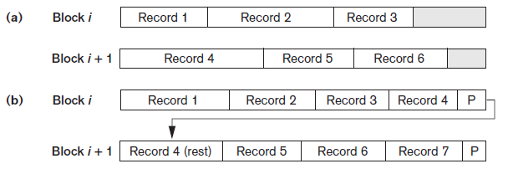
Record Blocking and Spanned Versus Unspanned Records (2 of 3)
Blocking factor
Average number of records per block for the file
Figure 16.6 Types of record organization (a) Unspanned (b) Spanned

Slide 21
Record Blocking and Spanned Versus Unspanned Records (3 of 3)
Allocating file blocks on disk
Contiguous allocation
Linked allocation
Indexed allocation
File header (file descriptor)
Contains file information needed by system programs
Disk addresses
Format descriptions

Slide 22
16.5 Operations on Files (1 of 2)
Retrieval operations
No change to file data
Update operations
File change by insertion, deletion, or modification
Records selected based on selection condition

Slide 23
16.5 Operations on Files (2 of 2)
Examples of operations for accessing file records
Open
Find
Read
FindNext
Delete
Insert
Close
Scan

Slide 24
16.6 Files of Unordered Records (Heap Files)
Heap (or pile) file
Records placed in file in order of insertion
Inserting a new record is very efficient
Searching for a record requires linear search
Deletion techniques
Rewrite the block
Use deletion marker

Slide 25
16.7 Files of Ordered Records (Sorted Files)
Ordered (sequential) file
Records sorted by ordering field
Called ordering key if ordering field is a key field
Advantages
Reading records in order of ordering key value is extremely efficient
Finding next record
Binary search technique

Slide 26
Access Times for Various File Organizations
Table 16.3 Average access times for a file of b blocks under basic file organizations
Type of Organization | Access/Search Method | Average Blocks to Access a Specific Record
Heap (unordered) | Sequential scan (linear search) | b over 2
Ordered | Sequential scan | b over 2
Ordered | Binary search | Log sub 2 b

Slide 27
16.8 Hashing Techniques (1 of 4)
Hash function (randomizing function)
Applied to hash field value of a record
Yields address of the disk block of stored record
Organization called hash file
Search condition is equality condition on the hash field
Hash field typically key field
Hashing also internal search structure
Used when group of records accessed exclusively by one field value

Slide 28
16.8 Hashing Techniques (2 of 4)
Internal hashing
Hash table
Collision
Hash field value for inserted record hashes to address already containing a different record
Collision resolution
Open addressing
Chaining
Multiple hashing

Slide 29
16.8 Hashing Techniques (3 of 4)
External hashing for disk files
Target address space made of buckets
Bucket: one disk block or contiguous blocks
Hashing function maps a key into relative bucket
Table in file header converts bucket number to disk block address
Collision problem less severe with buckets
Static hashing
Fixed number of buckets allocated

Slide 30
16.8 Hashing Techniques (4 of 4)
Hashing techniques that allow dynamic file expansion
Extendible hashing
File performance does not degrade as file grows
Dynamic hashing
Maintains tree-structured directory
Linear hashing
Allows hash file to expand and shrink buckets without needing a directory

Slide 31
16.9 Other Primary File Organizations
Files of mixed records
Relationships implemented by logical field references
Physical clustering
B-tree data structure
Column-based data storage

Slide 32
16.10 Parallelizing Disk Access Using R A I D Technology (1 of 4)
Redundant arrays of independent disks (R A I D)
Goal: improve disk speed and access time
Set of R A I D architectures (0 through 6)
Data striping
Bit-level striping
Block-level striping
Improving Performance with R A I D
Data striping achieves higher transfer rates

Slide 33
16.10 Parallelizing Disk Access Using R A I D Technology (2 of 4)
Improving reliability with R A I D
Redundancy techniques: mirroring and shadowing
R A I D organizations and levels
Level 0
Data striping, no redundant data
Spits data evenly across two or more disks
Level 1
Uses mirrored disks

Slide 34
16.10 Parallelizing Disk Access Using R A I D Technology (3 of 4)
Level 2
Hamming codes for memory-style redundancy
Error detection and correction
Level 3
Single parity disk relying on disk controller
Levels 4 and 5
Block-level data striping
Data distribution across all disks (level 5)

Slide 35
16.10 Parallelizing Disk Access Using R A I D Technology (4 of 4)
Level 6
Applies P+Q redundancy scheme
Protects against up to two disk failures by using just two redundant disks
Rebuilding easiest for R A I D level 1
Other levels require reconstruction by reading multiple disks
R A I D levels 3 and 5 preferred for large volume storage

Slide 36
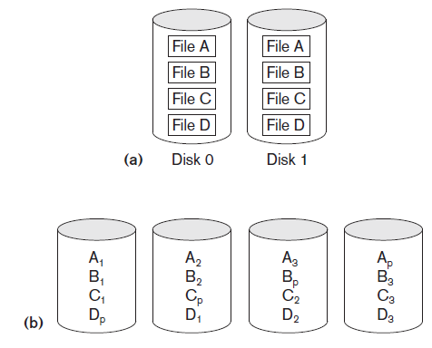
R A I D Levels
Figure 16.14 Some popular levels of R A I D (a) R A I D level 1: Mirroring of data on two disks (b) R A I D level 5: Striping of data with distributed parity across four disks

Slide 37
16.11 Modern Storage Architectures (1 of 3)
Storage area networks
Online storage peripherals configured as nodes on high-speed network
Network-attached storage
Servers used for file sharing
High degree of scalability, reliability, flexibility, performance
i S C S I
Clients send S C S I commands to S C S I storage devices on remote channels

Slide 38
16.11 Modern Storage Architectures (2 of 3)
Fibre Channel over I P (F C I P)
Fibre Channel control codes and data translated into I P packets
Transmitted between geographically distant Fibre Channel S A N s
Fibre Channel over Ethernet (F C o E)
Similar to i S C S I without the I P

Slide 39
16.11 Modern Storage Architectures (3 of 3)
Automated storage tiering
Automatically moves data between different storage types depending on need
Frequently-used data moved to solid-state drives
Object-based storage
Data managed in form of objects rather than files made of blocks
Objects carry metadata and global identifier
Ideally suited for scalable storage of unstructured data

Slide 40
16.12 Summary
Magnetic disks
Accessing a disk block is expensive
Commands for accessing file records
File organizations: unordered, ordered, hashed
R A I D
Modern storage trends

Slide 41

Copyright

